Slide 1

SYRACUSE CRIME ANALYTICS
DIVYANSHU PANDEY DEEP PATOLIYA DHRUV MAHABAL
SUMUKH PADALKAR

Slide 2
OBJECTIVE
Objective:
•Analyze Syracuse crime patterns and predict severity using data analytics and machine learning.
•Equip law enforcement with data-driven tools for resource optimization and proactive strategies.
Importance:
•Crime analytics informs urban safety strategies and resource optimization.
Scope:
•Understand "when," "where," and "what" types of crimes occur.
•Leverage the 2023 Syracuse Crime dataset for insights.

Slide 3
GOALS
Goals:
Optimize law enforcement resources by identifying high-crime areas and peak times.
Predict crime severity using machine learning to prioritize intervention for severe cases.
Enhance urban safety through actionable insights for policymakers.
Bridge raw data to actionable intelligence using visual and predictive analytics.
Interests:
Temporal Analysis: Identify peak crime hours (e.g., midnight-1 AM, 2-6 PM).
Spatial Analysis: Map crime hotspots using heatmaps (e.g., downtown Syracuse).
Severity Prediction: Use Gradient Boosting to classify and prioritize severe crimes.
Interdisciplinary Approach: Integrate data science, GIS, and criminology for urban safety solutions.

Slide 4
CHARACTERISTICS
Characteristics:
Comprehensive Data
•Contains spatial (latitude, longitude) and temporal (time, date) information for crimes.
•Enables exploration of trends across time and geography.
Categorical Diversity:
•Includes crime types (e.g., Larceny, Assault) and their classifications.
Temporal Relevance:
•Helps identify peak crime hours and seasonal trends.
Supports Machine Learning:
•Enables model training for crime severity prediction.
•Effective for creating predictive insights and visualizations like heatmaps and time-series plots.

Slide 5
Exploratory Data Analysis (EDA):
•Analyze temporal trends to identify peak crime times (e.g., midnight to 1 AM, 2-6 PM).
•Map spatial trends using heatmaps to locate crime hotspots (e.g., downtown Syracuse).
Machine Learning Pipeline:
Models Used:
•Random Forest: For baseline performance.
•Gradient Boosting: Tuned for better recall and accuracy in predicting high-severity crimes.
Create intuitive visuals to communicate findings effectively:
•Heatmaps for hotspots.
•Bar plots for crime type distribution.
•Time-series graphs for temporal patterns.

Slide 6
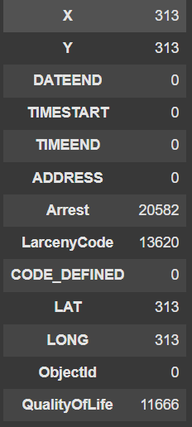
Data Cleaning
Handling Missing Values:
•Replaced missing or inconsistent values in key columns like time, latitude, and longitude with appropriate placeholders.
•Ensured no critical data was lost during cleaning.
Standardization:
•Reformatted date and time fields for consistency (e.g., TIMESTART standardized to 24-hour format).
•Mapped ambiguous or encoded values to descriptive labels (e.g., categorizing crime types).
Outlier Removal:
•Removed invalid entries, such as incorrect geolocation data or null timestamps.
Data Transformation
Feature Engineering:
•Created time bins for analyzing hourly crime patterns.
•Derived categorical variables such as crime severity for predictive modeling.
Spatial Transformation:
•Grouped geographical data into latitude and longitude bins for hotspot analysis.
•Used clustering to identify crime zones.
Data Aggregation:
•Grouped data by time, crime type, and location for efficient exploration.
•Aggregated frequency data to visualize trends effectively.
Machine Learning Readiness:
•Converted categorical variables into numerical formats for model training.
•Balanced the dataset to address class imbalances (e.g., high-severity crimes underrepresented).

Slide 7
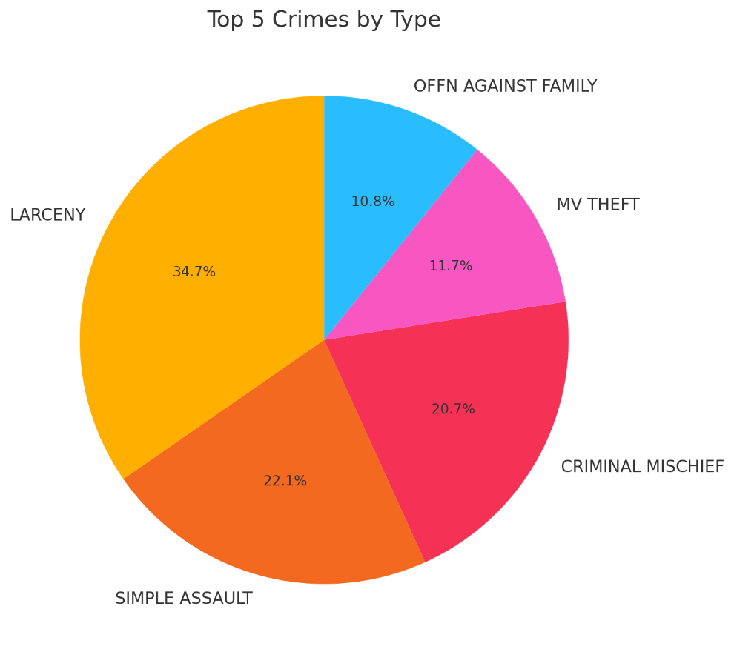
Visualizations
1. Crime Distribution by Type
Larceny: The most frequent crime, followed by Simple Assault and Criminal Mischief.
Actionable Insight: Focus law enforcement efforts on addressing property crimes to
significantly reduce overall crime rates

Slide 8
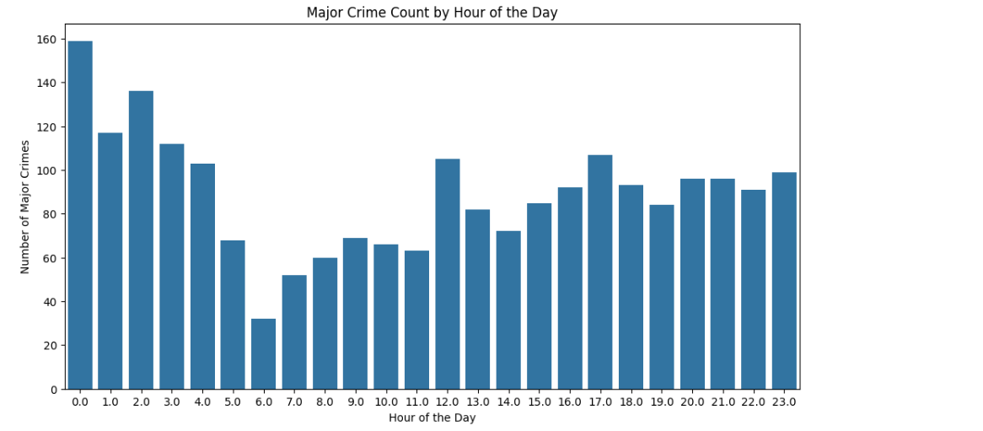
Visualizations
2. Temporal Trends
Peak Crime Hours: Midnight to 1:00 AM and 2:00 PM to 6:00 PM.
Seasonal Trends: Crime peaks during summer months (July and August) and significantly drops in winter months.
Actionable Insight: Optimize patrol scheduling during peak hours and months to enhance crime deterrence and response.

Slide 9
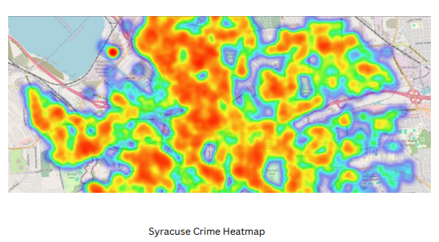
Visualizations
3. Spatial Analysis
Hotspots: Downtown Syracuse is identified as the most active crime area.
Actionable Insight: Target high-crime zones for resource allocation and community interventions.

Slide 10
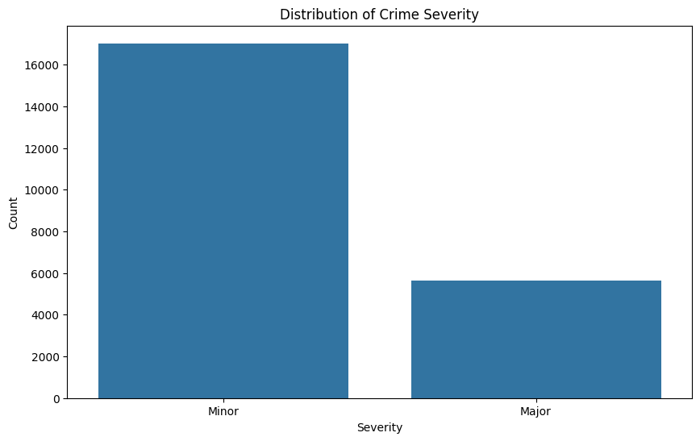
Visualizations
4. Crime Severity Distribution
Minor vs. Major Crimes: Majority of incidents are minor, but major crimes require immediate attention due to their severity.
.

Slide 11
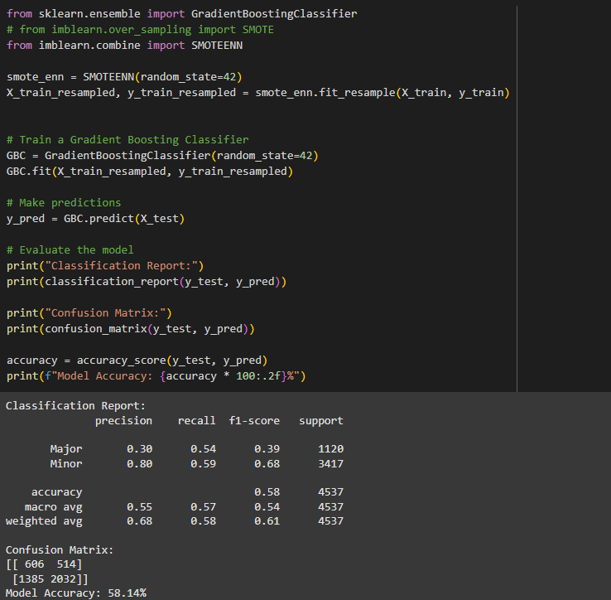
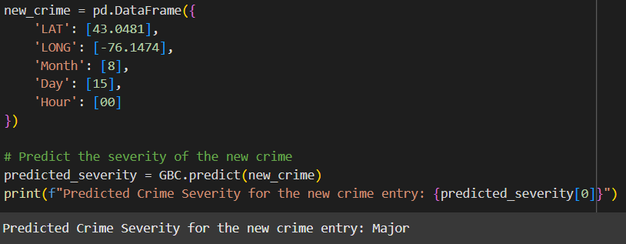
Model Building

Slide 12
THANK YOU

